Slide 1

Team 2 members
Sama Samer
Yousef Gamal
Ahmed Serag
Muhammed Mahmoud
Nada Salah
Adham Amr
Muhammed Ahmed
Tarnem Yousef
Muhammed Ahmed
Mohamed Ossama
Sigfox

Slide 2
Introduction to Sigfox
Sigfox is a global network operator that provides a cellular network specifically for Internet of Things (IoT) devices. It excels in connecting low-power, low-bandwidth devices and sending small amounts of data over long distances.

Slide 3

What is Sigfox?
Sigfox is a wireless network technology specializing in connecting low-power, long-range (LPWAN) devices. It operates on a dedicated, global network designed for sending small amounts of data over long distances, making it ideal for IoT applications.
LPWAN Network
Global Coverage
Focuses on low-power, long-range connectivity for IoT devices.
Provides connectivity across a vast network spanning multiple countries.
Low-Bandwidth Data
Suitable for transmitting small amounts of data, such as sensor readings or status updates.

Slide 4





Sigfox Network Architecture
The Sigfox network architecture consists of a hierarchy of base stations, gateways, and end devices. Signals from devices travel through the network to reach the cloud, where data can be processed and analyzed.
End Device
A sensor or actuator that collects and transmits data.
Base Station
A local network point that receives signals from end devices.
Gateway
A device that bridges communication between base stations and the cloud.
Cloud Platform
The central platform where data is processed, analyzed, and accessed.

Slide 5
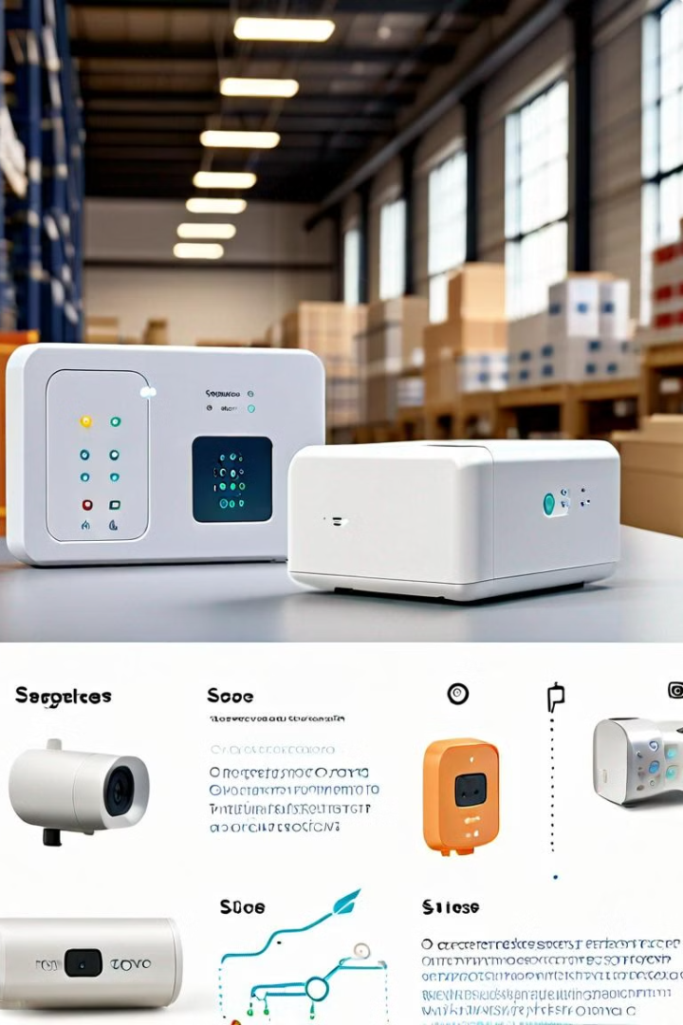
Sigfox Connectivity Features
Sigfox offers a range of connectivity features designed for low-power, long-range applications. These features include long battery life, extended range, and a simplified communication protocol.
1
Low Power Consumption
2
Long Range
Connects devices up to 50 km away from base stations, expanding coverage to rural and remote areas.
End devices can operate for years on a single battery, ideal for remote and inaccessible locations.
3
Simple Protocol
4
Secure Network
Streamlines communication by using a straightforward protocol, simplifying device integration and development.
Ensures secure data transmission through encryption and authentication protocols.

Slide 6

Sigfox Bandwidth
The Sigfox network operates on the 868 MHz and 915 MHz frequency bands, which are designated for low-power wide-area networks (LPWANs). These license-free ISM bands allow Sigfox devices to communicate over long distances while consuming very little power. The use of these global frequency bands ensures that Sigfox devices can be deployed and utilized around the world, providing seamless connectivity regardless of location. It uses ultra-narrowband (UNB) technology, This narrow bandwidth allows for very efficient use of the spectrum and supports long-range communication.

Slide 7

Sigfox Use Cases
Sigfox finds applications in a wide range of industries, including agriculture, smart cities, asset tracking, industrial automation, and environmental monitoring. The low-power, long-range connectivity enables data collection from remote and challenging environments.
Industry
Use Case
Agriculture
Soil moisture monitoring, livestock tracking
Smart Cities
Traffic management, waste bin monitoring, street lighting control
Asset Tracking
Tracking valuable equipment, logistics optimization
Industrial Automation
Remote machine monitoring, predictive maintenance
Environmental Monitoring
Air quality monitoring, water level monitoring, wildlife tracking

Slide 8





Advantages of Sigfox Technology
Sigfox offers several advantages over traditional cellular networks, making it a compelling option for specific IoT applications. These advantages include cost-effectiveness, low energy consumption, and global coverage.
Cost-Effective
Low Energy Consumption
Lower operational costs compared to traditional cellular networks, thanks to optimized network infrastructure and pricing models.
Devices can operate for extended periods without requiring frequent battery replacements.
Global Coverage
Security
Provides connectivity across a wide range of regions, enabling deployment in diverse locations.
Ensures secure data transmission through encryption and authentication protocols, safeguarding sensitive information.

Slide 9

Conclusion and Future Outlook
Sigfox plays a crucial role in enabling the Internet of Things by providing a cost-effective and reliable connectivity solution. As IoT adoption continues to grow, Sigfox is poised to be a key enabler for connecting a vast array of devices and applications.
1
Growth of IoT
The Internet of Things is expected to continue its exponential growth, driving the demand for reliable and efficient connectivity solutions.
2
Expanding Network Coverage
Sigfox is actively expanding its network coverage to new regions, ensuring wider accessibility and reach.
3
Advancements in Technology
Continued advancements in low-power, long-range technology will further enhance the capabilities of Sigfox and its applications.

